Slide 1
Course : 0553T / Multimedia System
Year : 2015
TEXT
Session 02

Slide 2
OUTLINE
Text Definition
Font and Faces
Using Text in Multimedia
Font Editing and Design Tools
Hypermedia and Hypertext
Guidelines for The Use of Text

Slide 3
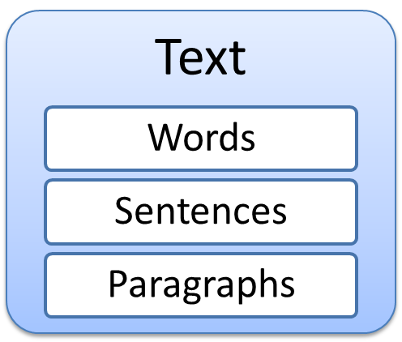
DEFINITION
Basic media for many multimedia systems
is used to communicate
thoughts, ideas and facts
in nearly every aspect of our lives

Slide 4
DEFINITION
The Power of Meaning
  Multimedia authors weave words, symbols, sounds, and image then blend text into the mix to create integrated tools and interfaces for acquiring, displaying, disseminating messages and data.
  It’s important to design labels for title screens, menus and buttons or tabs using words that have the most precise and powerful meanings

Slide 5
Font and Faces
Face or TypeFace :
  A family of graphic character that usually includes many type size and styles.
Font :
  A collection of characters of a single size and style belonging to a particular typeface family.
  Font style : Boldface, Italic, Underlining, Outlining of Characters.

Slide 6
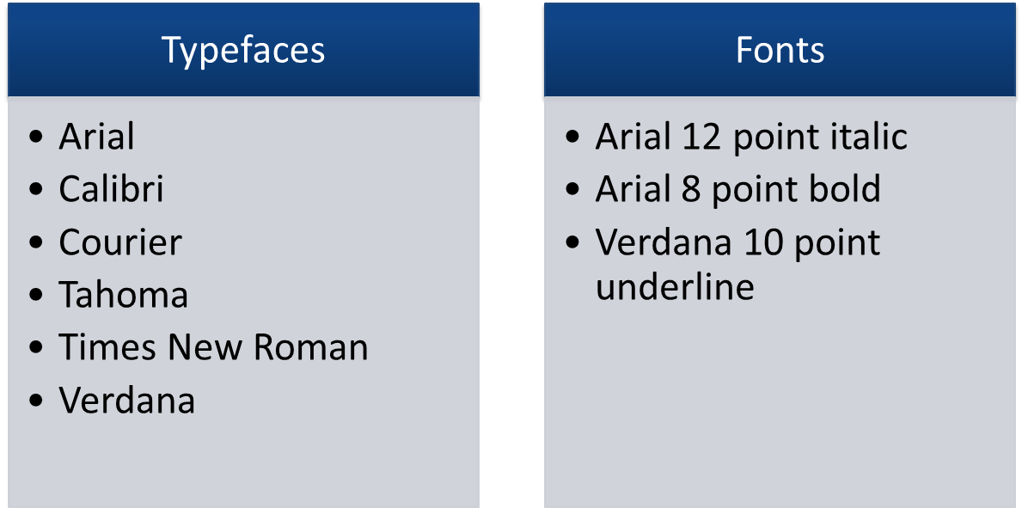
Font and Faces
Typeface vs Font

Slide 7
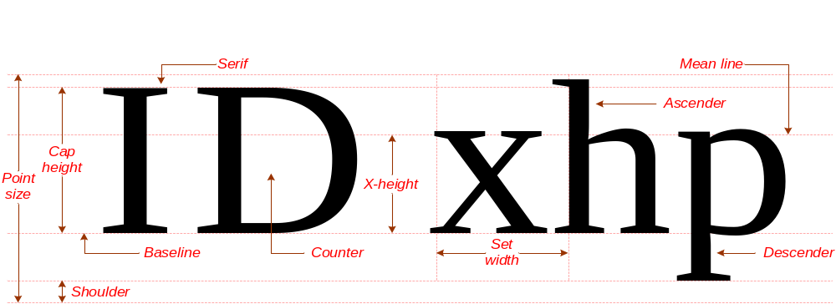
Font and Faces
The Measurement of Type ( Figure 2.1)

Slide 8
Font and Faces
Description Terminology ( see figure 2.1)
  x-height : the height of the lowercase letter x
  Point : a measure of the size of type.
  1 point = 0.0138 inch (about 1/72 inch)
  Descender : the portion of the letter normally written below a line(base line)
  Ascender : the portion of the letter normally written above a line(mean line)

Slide 9
Font and Faces
Character metrics : general measurements applied to individual characters.
Kerning : Process of adjusting the spacing between pairs of letters
Example :
Av
A
v
Unkerned
Kerned

Slide 10
Font and Faces
Tracking : Adjusting the spacing between characters
Tight
tracking
Loose
tracking

Slide 11
Font and Faces
Leading : Process of adjusting the spacing between lines of text.
Example :
Leading 0.5 pt
The buzzword being splashed around is Convergence and by it we mean the convergence of multimedia technology with the telecommunications industry.
1 pt = 0.0138 inch.
Leading 1 pt
The buzzword being splashed around is Convergence and by it we mean the convergence of multimedia technology with the telecommunications industry.

Slide 12
Font and Faces
Two categorize of typeface is :
Serif | Sans Serif
A
A

Slide 13
Font and Faces
Serif :
  The little decoration at the end of a letter stroke
  Example of Serif fonts : Times, New Century Schoolbook, Bookman, and Palatino.
Sans Serif :
  This text typically has a clean ,bold look.
  Example of San Serif fonts : Helvetica, Verdana, Arial, Optima, and Avant Garde

Slide 14
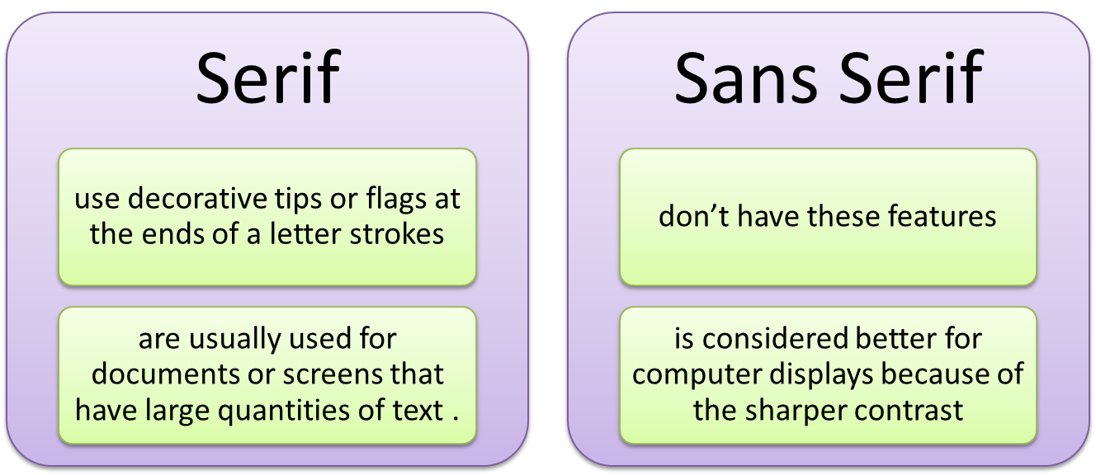
Font and Faces
Serif vs Sans Serif

Slide 15
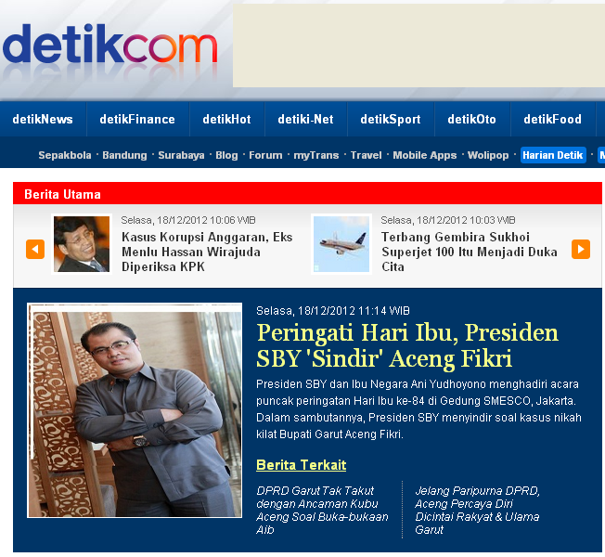
Using Text In Multimedia
Use Text for :
Title and Headlines
(what it’s all about)
Menus
(where to go)
Navigation
(how to get there)
Content
(what you see
when you get there)

Slide 16
Using Text In Multimedia
Designing with Text :
  For design perspective
    Font size and the number of headlines on a particular screen must be related both to the complexity of your message and its venue.
  Creating presentation slides for public-speaking support :
    Use bullet in large fonts and few words with lot of white space.

Slide 17
Using Text In Multimedia
  Choosing Text Font :
    Installed Fonts : font that recognized by the computer’s operating system.
      Use of CSS ( Cascading Style Sheets) : specify a base font size, color, and other attributes for displaying text.
      Animating Text : there are plenty ways to retain a viewer’s attention when displaying text. For Example : animate bulleted text and have it “fly” onto the screen.

Slide 18
Using Text In Multimedia
  Symbols and Icons :
    Symbols are concentrated text in the form of stand-alone graphic constructs.
    Icons are symbolic presentation of objects and processes common to the graphical user interfaces of many computer operating systems.
    In Multimedia, symbols or Icons should be treated as text or visual words because they carry meaning.

Slide 19


Using Text In Multimedia
Example of Symbols : Example of Icons :

Slide 20
Using Text In Multimedia
Menus For Navigation
  The simplest menus consist of text lists of topics.
  Text is helpful to users to provide perpetual cues their location within the body of content.
  Example :
    Store -> Home & Garden -> Patio&Grilling

Slide 21
Using Text In Multimedia
Buttons for Interaction
  In Multimedia, Buttons are the objects, such as blocks of text, a pretty blue triangle, or a a photograph that make things happen when they are clicked or tapped.
  Pick a font for buttons, legible, then adjust the text size of the labels to provide adequate space between the button’s rim and the text.
  Example of Buttons :

Slide 22
Using Text In Multimedia
Fields for Reading :
  Use a font that is easy to read rather than a prettier font that is illegible.
  There are two orientations : portrait and landscape

Slide 23
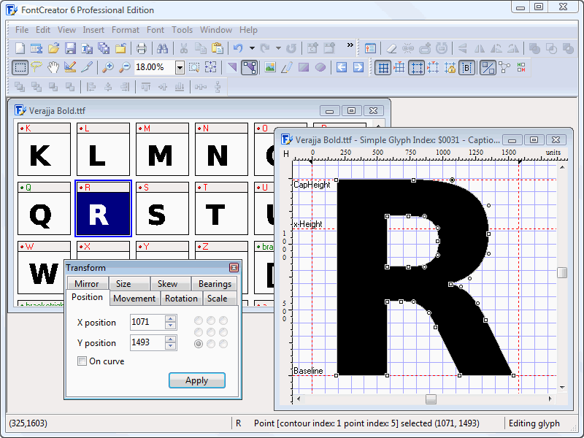
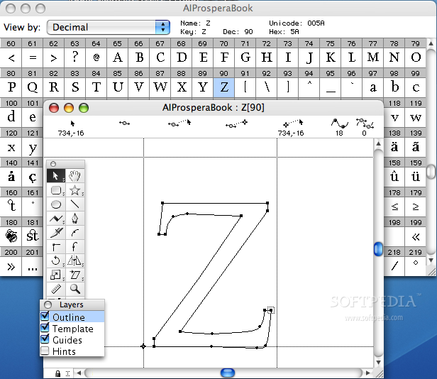
Font Editing and Design Tools
Special font editing tools can be used to make your own type. The tools are :
  Fontographer - FontCreator

Slide 24
Hypermedia and Hypertext
Interactive Multimedia becomes Hypermedia when its designer provides a structure of linked elements through which a user can navigate and interact.
Hypertext : the organized cross-linking of words not only to other words but also to associated images, video clips, sounds, and other exhibits.
Two buzzwords used often in hypertext system are link and node.

Slide 25
Hypermedia and Hypertext
Links : connection between the conceptual elements. Links are the navigation pathways and menus.
Nodes : consists of text, graphics, sounds, or related information in the knowledge base. Nodes are accessible topics, documents, messages and content elements.
Hypertext systems are currently used for electronic publishing and reference works, technical documentations, educational courseware, interactive kiosk, electronic catalogs, interactive fiction, and text and image databases.

Slide 26
Guidelines for The Use of Text
The following guidelines for the use of Text :
  Be Selective
  Be Brief
  Make Text Readable
  Be Consistent
  Be Careful
  Be Respectful
  Combine Text with other media
  Make text interactive

Slide 27
Choosing Text Font
For small type, use most legible font, decoratif font cant read useless
Use few different faces, style, to much font called ransom-note typography.
In text block, adjust leading font, pleasing line spaces
Vary size in proportion for message delivering
Adjust spacing between letter(kerning) for large headlines
Explore effect different color in different background
Using antialiasing for gentle and blended text

Slide 28

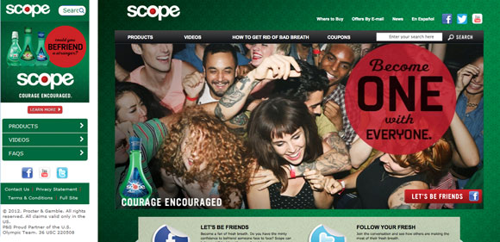

Slide 29
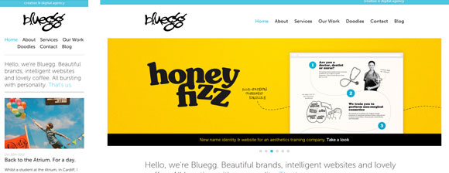
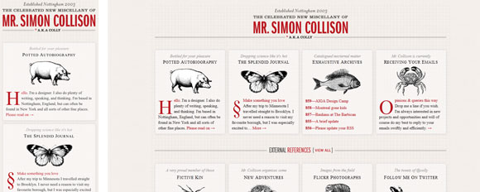

Slide 30
SUPPORTING MATERIAL
http://www.w3.org/TR/html4/
http://www.fontfoundry.com/
http://www.webstyleguide.com/wsg3/8-typography/4-web-typefaces.html
http://efuse.com/Design/web_fonts_basics.html
http://www.webdesignerdepot.com/2015/02/7-simple-rules-for-mobile-typography/
https://www.smashingmagazine.com/2010/12/what-font-should-i-use-five-principles-for-choosing-and-using-typefaces/
https://tympanus.net/codrops/2012/11/12/mobile-design-typography-is-vitally-important-and-challenging/

Slide 31
Exercise
Explain the difference between Font and Typeface!
Discuss the difference between Leading and Kerning! Explain your answer with example!
When you design a multimedia on mobile, what think you must consider? Mengapa kita perlu memperhatikan font tersebut

